Slide 1
Binary Bracelets

Slide 2
Objectives
Encode letters into binary
Decode binary back to letters
Relate the idea of storing initials on a bracelet to the idea of storing information in a computer

Slide 3
Vocabulary

Slide 4
Short Message in Binary Code
What does the message say?

Slide 5
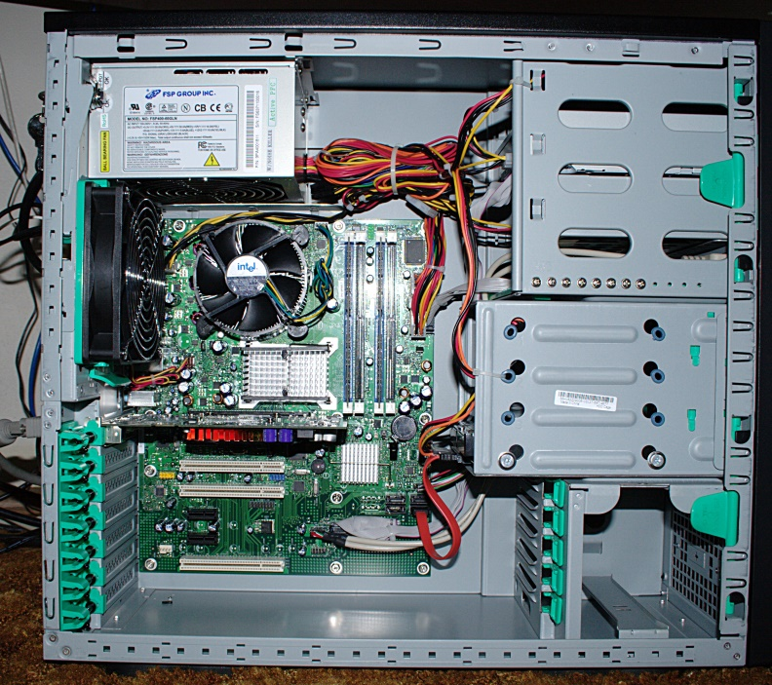
Question??
Have you seen the inside of a computer?
What’s in there?
Wires carry information through the machine in the form of electricity

Slide 6
Computer Facts!
The two options that a computer uses with respect to this electrical information are “off” and “on”
When computers represent information using only two options, it’s called “Binary”.
That theme of two options doesn’t stop when the information gets to its destination.

Slide 7
Computer Facts!
Computers also store information using binary.
Hard Disk Drivers store information using magnetic positive and magnetic negatives
DVDs store information as either reflective or non-reflective
How do you suppose we can convert the things we store in a computer into binary?

Slide 8
Computer Facts!
Let’s start with letters. Hand out Binary Decoder Key.
Each spot where you have a binary option is called a “binary digit” or “bit” for short
What is a grouping of eight bits called?
A byte
What is a grouping of four bits called?
A nibble

Slide 9
Short Message in Binary Code
What does the message say?

Slide 10
Short Message in Binary Code
What does the message say?
HELLO

Slide 11
Binary Bracelets
Find the first letter of your first name in the Binary Decoder Key.
Fill in the squares of the provided bracelet to match the pattern of the squares next to the letter that you selected.
Grab a pipe cleaner.
Grab the black and white beads you need to represent your bracelet.
Create your bracelet to wear!

Slide 12
Binary Assessment
Fill out the Binary Assessment independently.
Check answers with me when completed!

